Slide 1



A Strategic Enhancement Plan for
Sri Sai Laundry Services
PRESENTATION BY
SHAMANTHAK REDDY MALLU
ROLL NO. 23F2001942

Slide 2
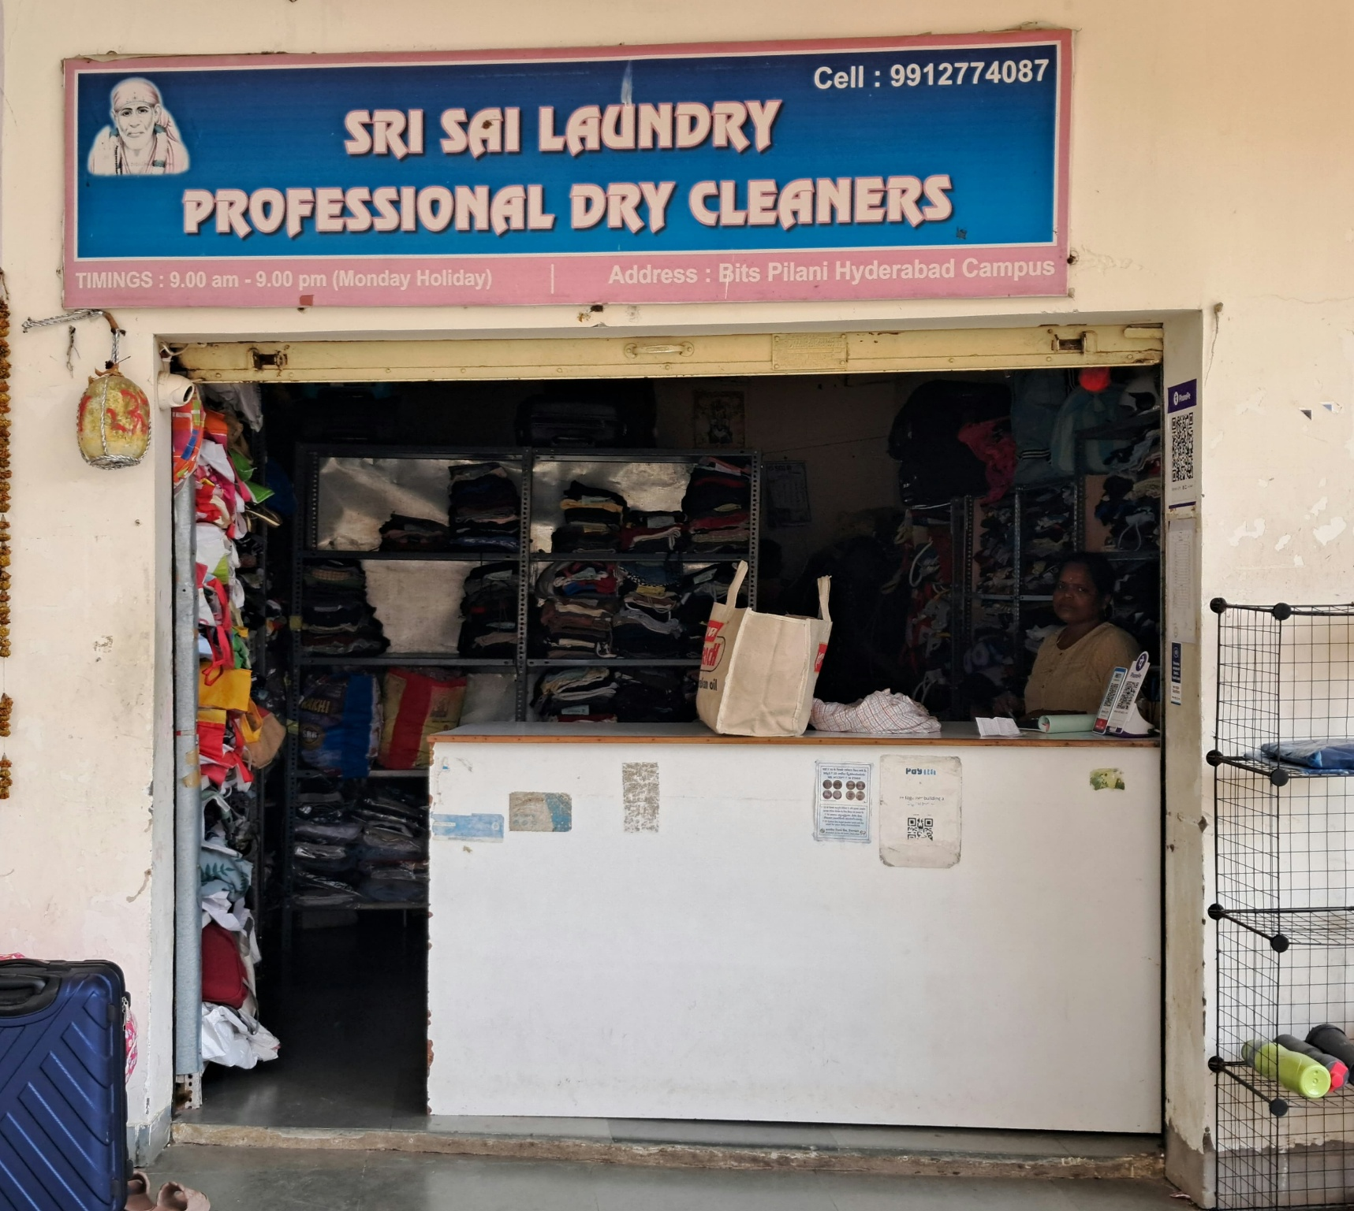



ABOUT THE PROJECT
A campus-based laundry business, namely Sri Sai Laundry Services, was chosen for the data analysis project. 12-week primary data was collected, cleaned, and analyzed to identify inefficiencies and suggest improvements.
The objective of the project was to understand key operational and financial challenges and use data-driven techniques to suggest practical solutions that would help the owner run the business more efficiently.
PROBLEM STATEMENTS
1
2
3
1
2
3
Limited space and disorganized storage resulting in delays and restricted order capacity.
Weather disruptions (rain, humidity) leading to increased utility costs and service delays.
High expenses due to outsourced dry-cleaning affecting profit margins.

Slide 3




PROBLEM SOLVING APPROACH
Space Optimization :
Uses K-Means clustering to analyze order density from different hostels and faculty blocks
Identity high, medium and low demand zones based on frequency and revenue
Reorganize storage and collection routes to prioritize high-demand clusters
Weather-Adaptive Strategy :
Use regression analysis to study correlation between rainfall/humidity and operational costs.
Identify peak cost periods linked to rainy days.
Recommend installation of dryers and semi-covered drying sheds.
Cost-Best Optimization
Conduct a CBA comparing in-house dry-cleaning vs outsourced services.
Analyze actual vs projected costs using NPV calculations.
Propose in-house setup with fixed monthly costs of ₹22,500 to improve profit margins.

Slide 4

DATA COLLECTED
Time Period of Data Collected : 12-weeks (October 2024 to December 2024)
Washing & Ironing Sales Data (Daily) :
This sheet holds daily records of customer transactions – includes Room No. (hostel/faculty block) and Amount charged per order.
Dry Cleaning Sales Data (Daily) :
This sheet records daily dry cleaning transactions, the number of orders, and corresponding revenue earned.
Operational Costs Data (Monthly) :
This sheet contains monthly expenses under categories like Salaries, Rent, Transportation, Electricity, Water, Detergents, etc.

Slide 5

ANALYSIS PROCESS
Data Pre-processing :
Data from merchant copy bills manually entered into Excel.
COUNTIFS formula used to identify and remove duplicate entries.
Missing/invalid entries were discarded.
Room numbers were normalized to identify student and faculty zones.
Descriptive and Statistical Analysis
With the help of Excel, got summary statistics (MAX, MIN, AVERAGE, SUM)
Monthly revenue and cost patterns extracted and visualized.
Created trend charts for daily orders and income across 12 weeks.
Diagnostic Analysis
Analyzed customer blocks using K-Means clustering to identify :
High-demand zones
Medium/Low-demand zones
Analyzed weather’s effect using linear regression (rainy days vs utility costs).
Compared outsourcing vs in-house costs using CBA and NPV in Excel and Python.

Slide 6
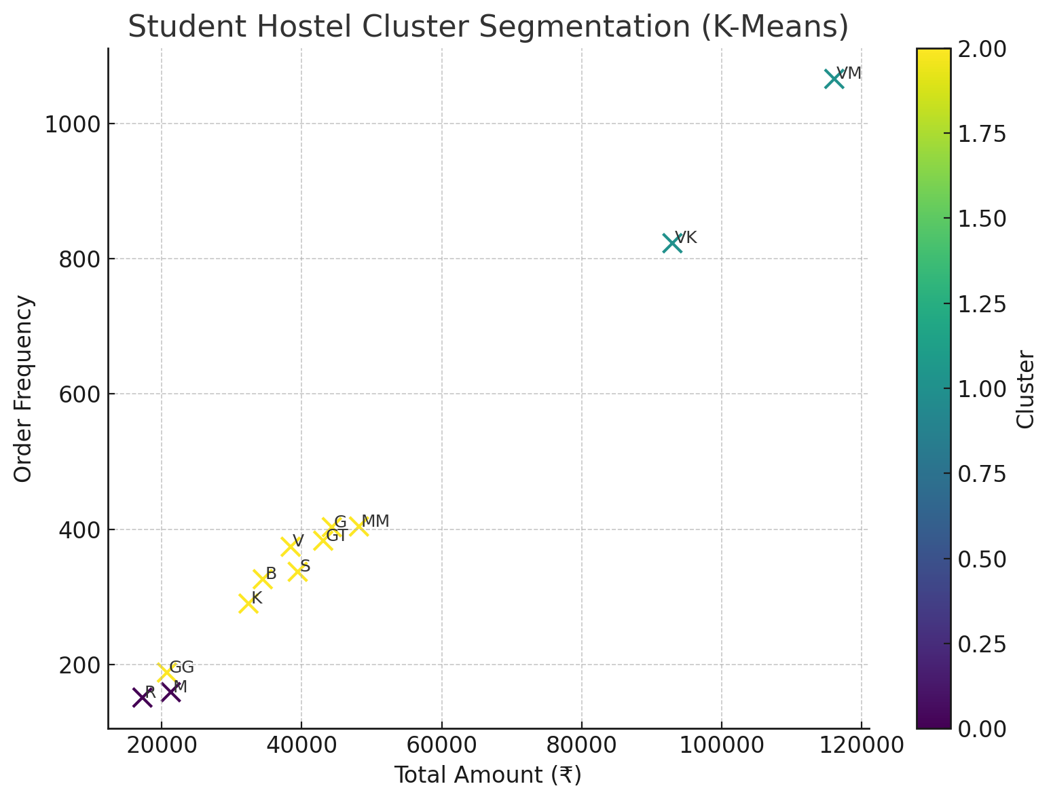
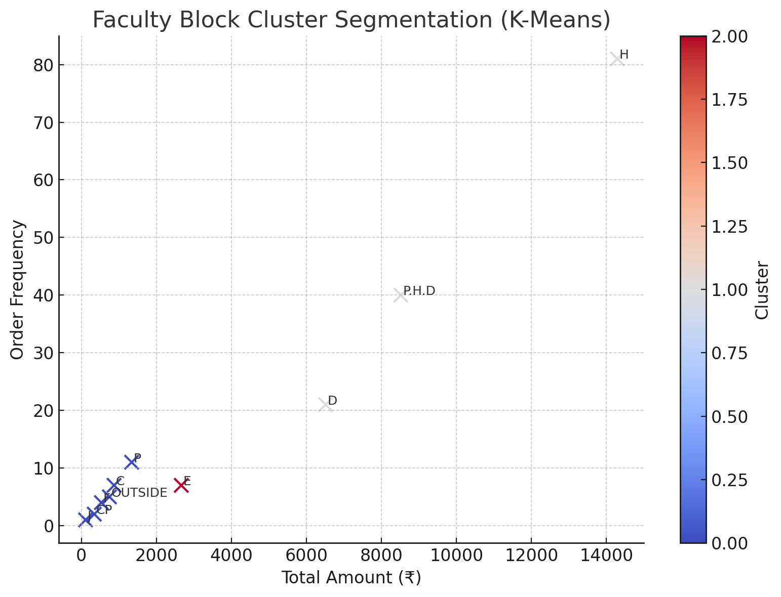
RESULTS
Segmented customer orders from student and faculty blocks.
Valmiki Bhavan (VM) – 21.7% of all orders
Vishwakarma Bhavan (VK) – 16.8%
H Block – 45.5% of faculty orders
Ph.D. Quarters – 22.5%
These top 4 clusters alone generated nearly 40%+ of business — identified as priority zones for faster pickups and special storage.

Slide 7
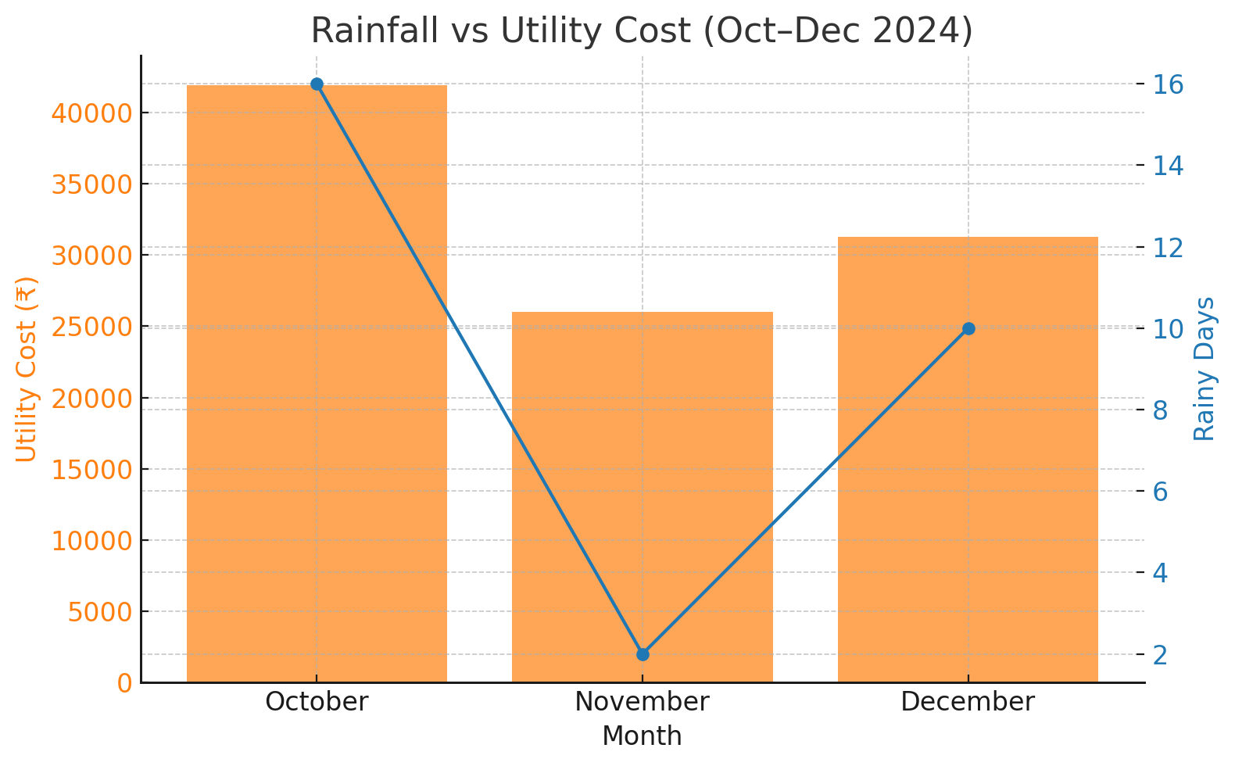
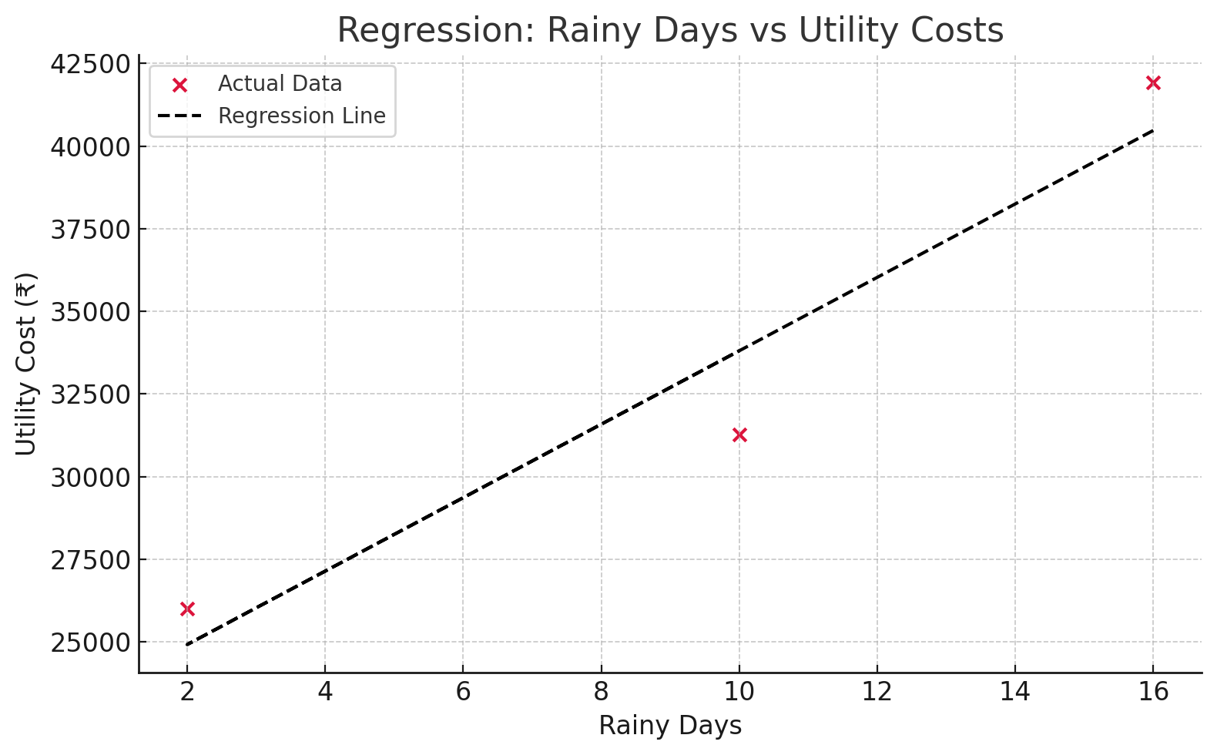
RESULTS
Regression Analysis: Rainfall vs Utility Costs.
Highest cost in October (16 rainy days → ₹41,924 total cost)
R² = 0.926 → 92.6% of utility cost variance explained by rainy days
Every rainy day → ₹1,111.32 increase in utility cost (β₁)
Strong correlation shows need for weather-adaptive infrastructure to reduce cost impact during monsoon.

Slide 8
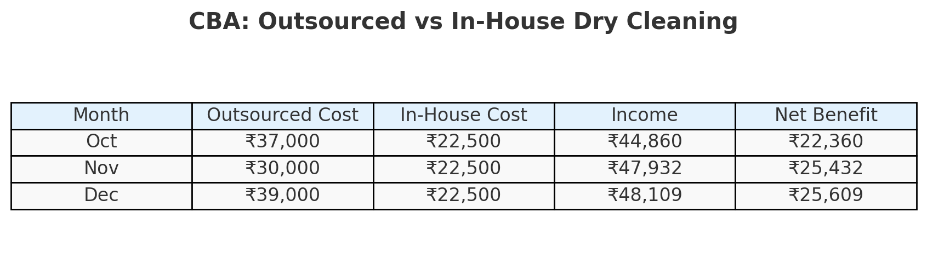
.
RESULTS
Outsourcing costs are inconsistent and higher, ranging from ₹30,000–₹39,000.
In-house operations stay fixed at ₹22,500/month, offering cost stability.
Monthly income from dry cleaning consistently exceeds ₹44,000, ensuring healthy margins
Total Net Benefit from in-house model: ₹73,401
Transitioning to an in-house dry-cleaning setup is not just cost-effective but also strategically sound — offering consistent monthly savings, operational control, and a fast return on investment within just a few months.

Slide 9




RECOMMENDATIONS
Reorganize storage and pickup routes to prioritize high-demand clusters like VM, VK, and H Block for faster order processing.
Install dryers or semi-covered drying areas before monsoon to reduce rewashing and utility costs caused by rainy weather.
Shift dry-cleaning operations in-house to save up to ₹25,000 monthly and achieve faster, more controlled service delivery.
STRATEGY 1
STRATEGY 2
STRATEGY 3

Slide 10

THANK YOU

